Slide 1
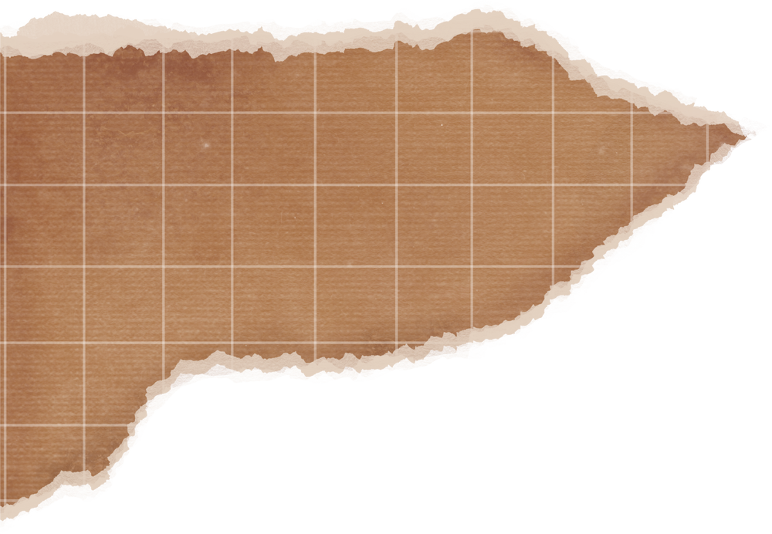


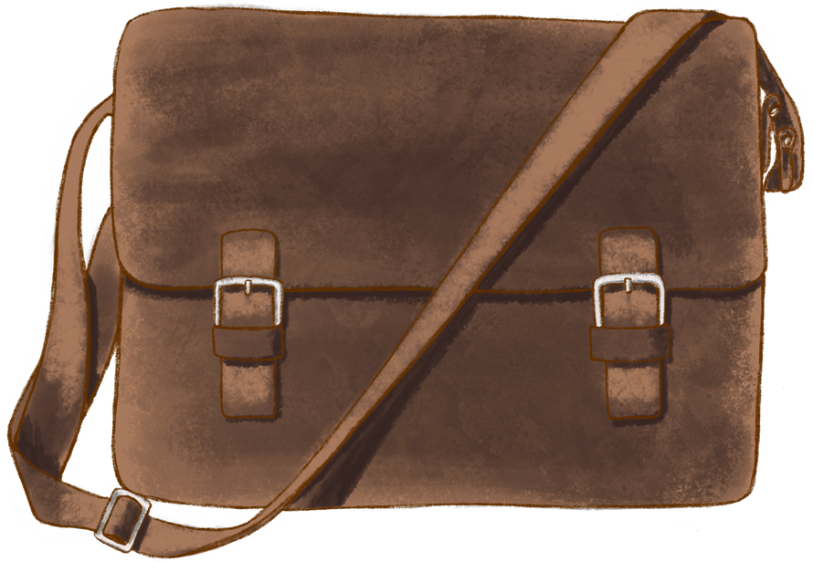


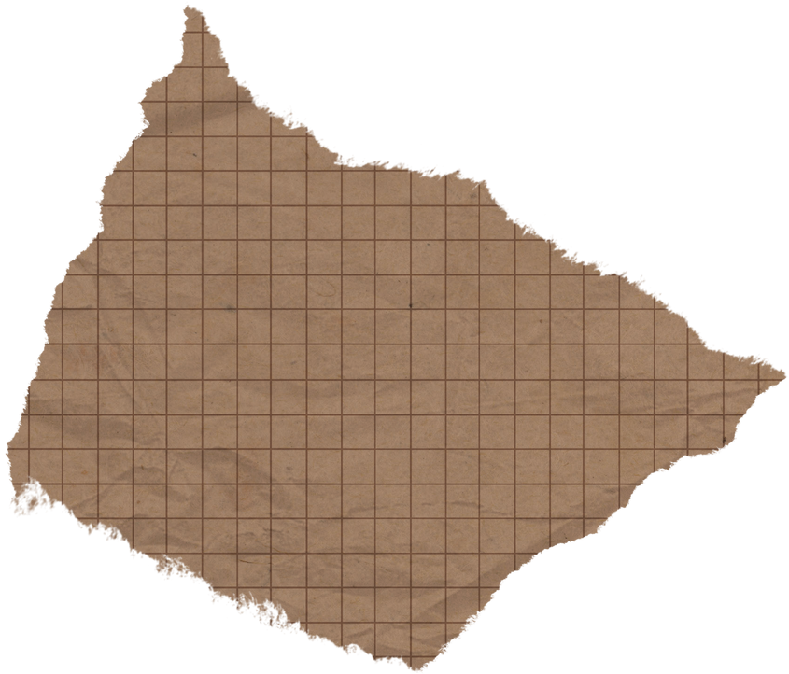
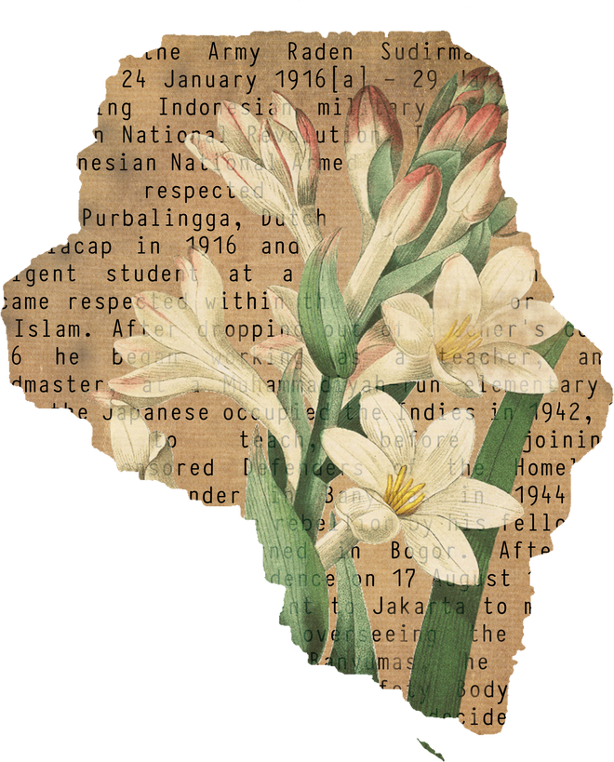

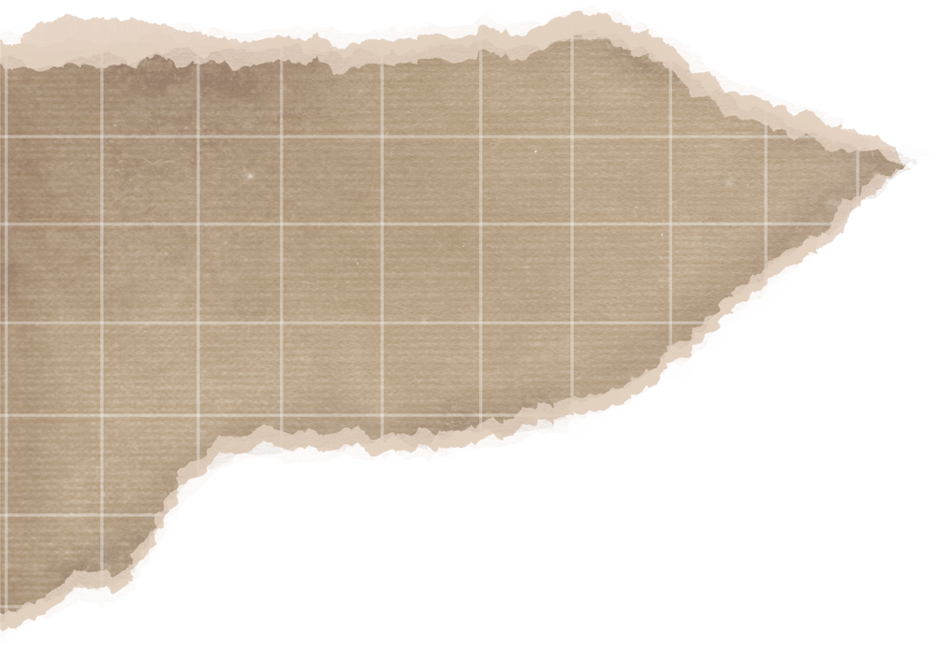
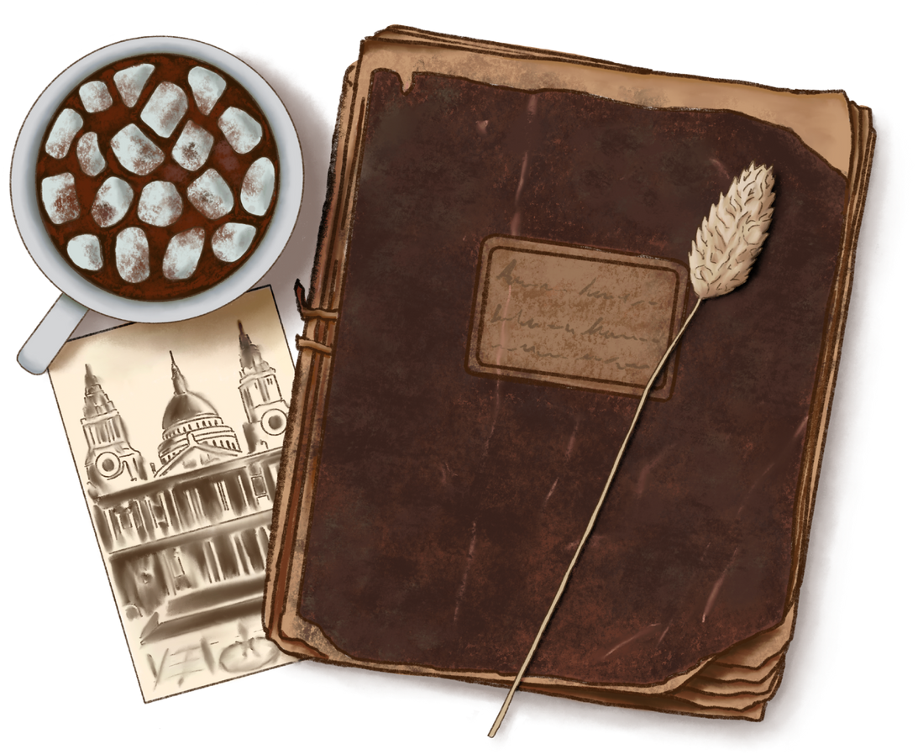
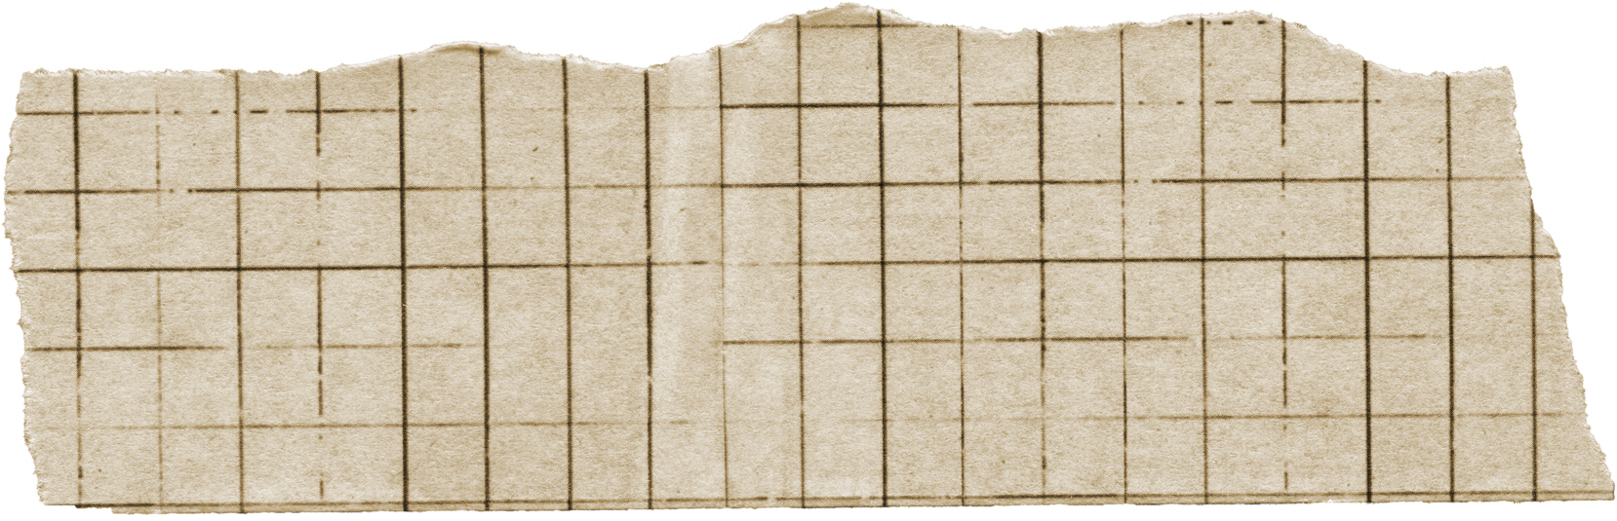
Time Chronicles
Our Journey Through Art, History, & Fashion
Presented by
Team Xinergy
~Unveiling the Interconnected Stories of Human Creativity~

Slide 2
meet the team
Programmer....
Lim Xin Bing
Designer....
Lim Xin Ru

Slide 3
why we make this?
"Time Chronicles": Unveiling Our Shared Human Story
~This website is a digital time machine for your brain.~
People get to explore the evolution of human creativity and life from cave paintings to AI art, lost cities to modern metropolises, and from traditional attire to future AI-generated fashion through this website.
Divided into three easy sections:
🎨
Art Through Ages
From cave paintings to digital masterpieces, trace the evolution of human expression.
🏛️
Historical Eras
Explore pivotal moments that shaped civilizations across millennia.
👗
Fashion Evolution
Witness how clothing reflects cultural changes through the centuries.

Slide 4
Who is "Time Chronicles" For?
Everyone curious about the world around them, especially STUDENTS
Why Students?
Traditional learning can feel DULL; we've focused on making learning an adventure.
BUT
This website is DIFFERENT
It makes learning about history, art, and fashion
EXCITING, INTERACTIVE, and ENGAGING,
transforming it into an exploration rather than a traditional lecture.

Slide 5


Art Through Ages
Art has always been part of human life — from drawing on cave walls to creating cool digital pictures today. It tells our stories, shows our feelings, and helps us share ideas across time and space!
Deep Dives into Art:
1
Direct links to the arts on WIKIPEDIA for detailed information (creation, reasons, artists).

Slide 6

Art Through Ages
Art has always been part of human life — from drawing on cave walls to creating cool digital pictures today. It tells our stories, shows our feelings, and helps us share ideas across time and space!
Experience AI Art Creation
2
Integration with CRAIYON AI ART GENERATOR to experiment with AI art based on user ideas.

Slide 7

Art Through Ages
Art has always been part of human life — from drawing on cave walls to creating cool digital pictures today. It tells our stories, shows our feelings, and helps us share ideas across time and space!
Fun Facts & Quizzes
3
Surprising FACTS about art and quick QUIZZES on different art types and famous artists.

Slide 8

documentation
p.s. art part

Slide 9
Historical Eras
This section proves that learning history is fun, deepens understanding, and appreciates the human journey.
1
Interactive Mini-Games
PREHISTORY
Matching game
ANCIENT CIVILIZATIONS
Puzzles
MIDDLE AGES
Decision Quest
RENAISSANCE & ENLIGHTENMENT
FIND the Pairs
MODERN ERA
Build Timeline
CONTEMPORARY ERA
Cause-and-effect challenges.

Slide 10
Historical Eras
This section proves that learning history is fun, deepens understanding, and appreciates the human journey.
Videos
2
Captivating videos to visually showcase HISTORICAL EVOLUTION.

Slide 11
documentation
p.s. history part

Slide 12
Fashion Evolution
The fashion industry has a significant impact on our planet. From the resources used to make our clothes to the waste created when we dispose of them, it's essential to be aware of our "fashion footprint."
Curated Journey
1
EXPLORE unique fashion designs, technology influences, and inspiring quotes from iconic figures.

Slide 13
Fashion Evolution
The fashion industry has a significant impact on our planet. From the resources used to make our clothes to the waste created when we dispose of them, it's essential to be aware of our "fashion footprint."
AI Chatbot
INTERACTIVE CHATBOX for personalised fashion advice
(e.g., "What to wear?", "Current trends?", "Menswear?", "How to style this?").
2

Slide 14
Fashion Evolution
The fashion industry has a significant impact on our planet. From the resources used to make our clothes to the waste created when we dispose of them, it's essential to be aware of our "fashion footprint."
Sustainability Focus
3
EMPHASISE fashion's environmental footprint, sustainable practices, eco-friendly materials, and upcycling.

Slide 15
Fashion Evolution
The fashion industry has a significant impact on our planet. From the resources used to make our clothes to the waste created when we dispose of them, it's essential to be aware of our "fashion footprint."
Videos
4
Immersive videos showcasing the EVOLUTION OF FASHION.

Slide 16
documentation
p.s. fashion part

Slide 17

Key Features
1
2
3
Categorized Navigation
Interactive Learning Modules
Curated Educational Content
Intuitive "Art," "History," "Fashion" sections for easy browsing.
Quick summary of AI Art, Mini-Games, AI Chatbot
Well-researched info, fun facts, quizzes
4
5
Immersive Video Content
Responsive Design
Visual journeys in History and Fashion
Accessible and optimised for all devices (desktop to mobile).

Slide 18
documentation
p.s. features’ pic

Slide 19



Language used
CSS
HTML
Java Script
Styling and visual appeal
Structuring content
Interactive elements and dynamic features

Slide 20
documentation
p.s. code example....

Slide 21
documentation
p.s. code example....

Slide 22
Future Vision
Exciting Ideas for Future Enhancements
1
2
3
User Accounts & Progress Tracking
Augmented Reality (AR) Features
Community Forum/Social Sharing
Save favourites, track quiz scores, module progress, and leaderboards.
"Try on" historical garments, view 3D artefacts via phone camera.
Discuss topics, share AI art, exchange styling tips, and share facts.
4
5
Personalized Content Recommendations
Gamification Leaderboards & Badges
Algorithm-based suggestions based on user interactions.
Further integrate game elements, encouraging engagement.

Slide 23
documentation
enhancement

Slide 24
Demonstration

Slide 25
Your Journey Awaits!
Visit Our Website
link
QR code
LOGO

Slide 26
thank you
QR code
logo
Presented by
Team Xinergy

